Slide 1




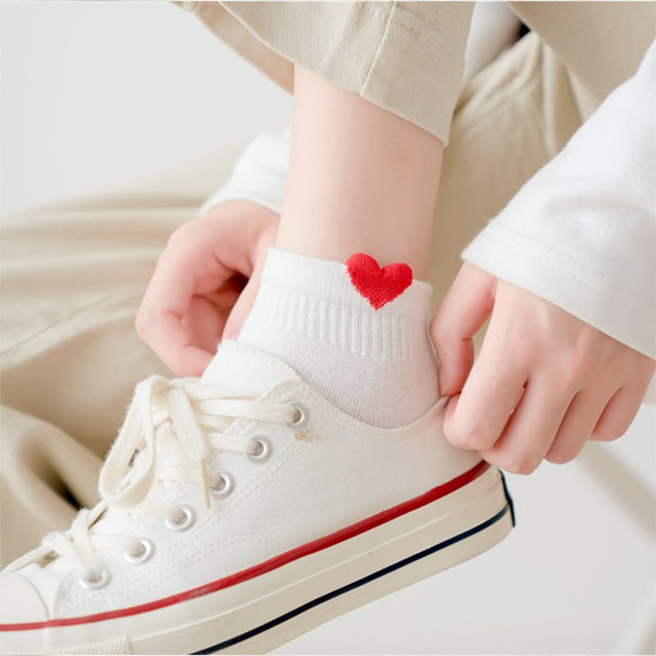
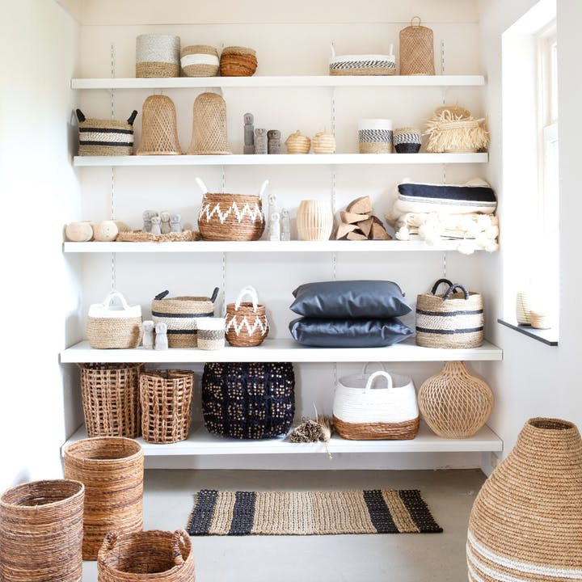
Concept & Demo
Houda EL BACHRI

Slide 2
Planning the process
Market research
Analysis
Develop

Slide 3

Market research
How can we know which brands are most in demand or which brands we should add?
Adds a contribution space
Comments the product or brand
A chat room with virtual assistants
listening to the customer
Scraping all this information for analysis
Likes rated from 1 to 5
know their needs

Slide 4




Analysis
Web Scraping (Python)
NLP
Analysis of feelings
Html tags (Beautiful Soup, Selenium …)
API
04

Slide 5
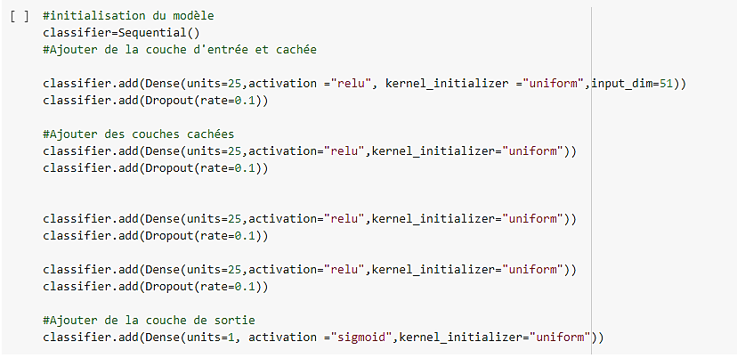
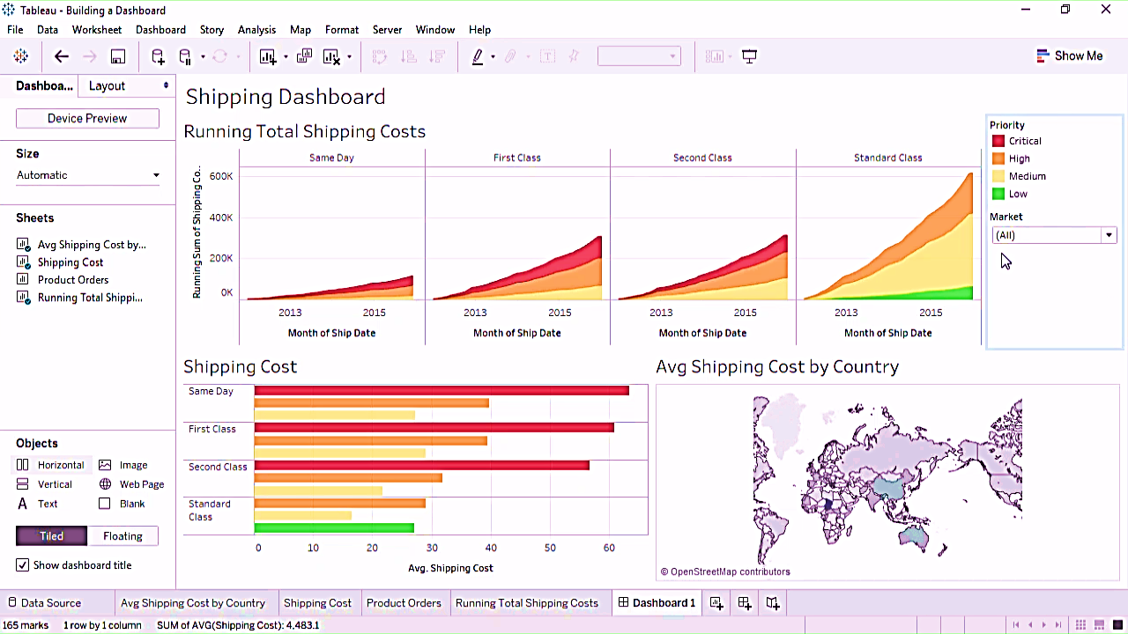
Model to predict (ML/DL)
Dashboard
Develop
05
Concept & Demo

Slide 6
Conclusion
All these tasks and process help us to know the needs of our customers and of course to increase our profits, this is really what should we do if we want to know the brands to add to our company.
Let's apply this to a use case
06

Slide 7
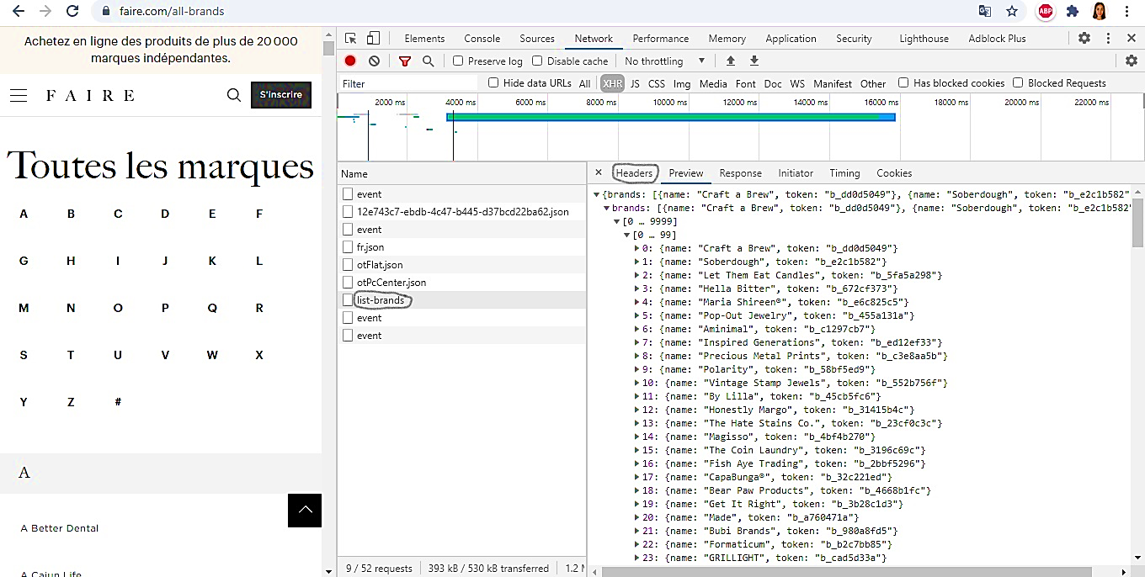
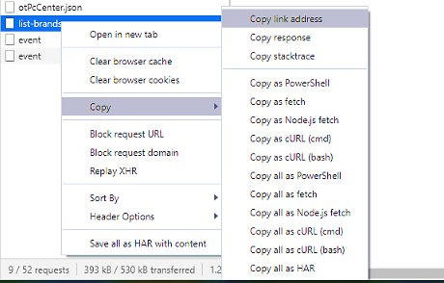
Scraping Faire.com for brand names, countries, and 1-2 categories by using the API
We access to the web site of all brands
We will scrape the tokens of the brands after that we can scrape the other characters and we should also use the headers
https://www.faire.com/all-brands

Slide 8
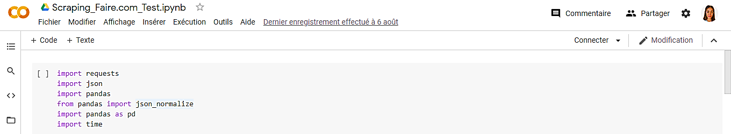
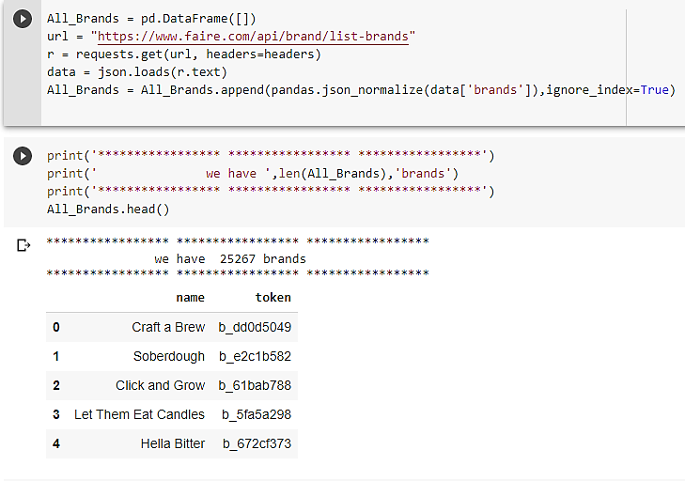
Scripts
we got the tokens and store them in All_Brands to index them in the url that will scrape us all the information of each brand

Slide 9
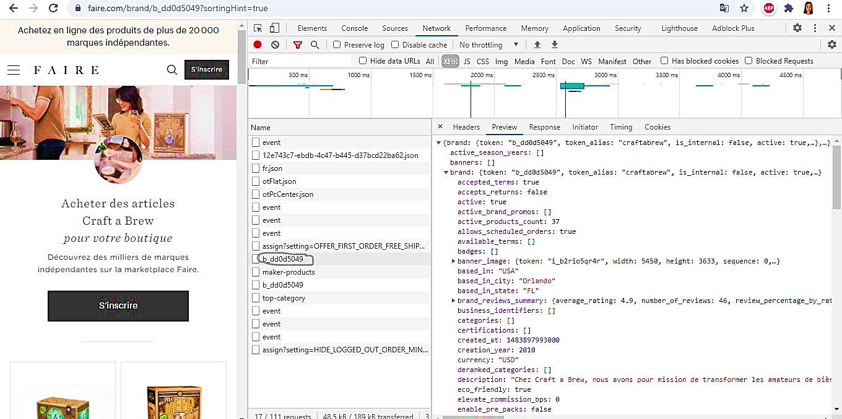
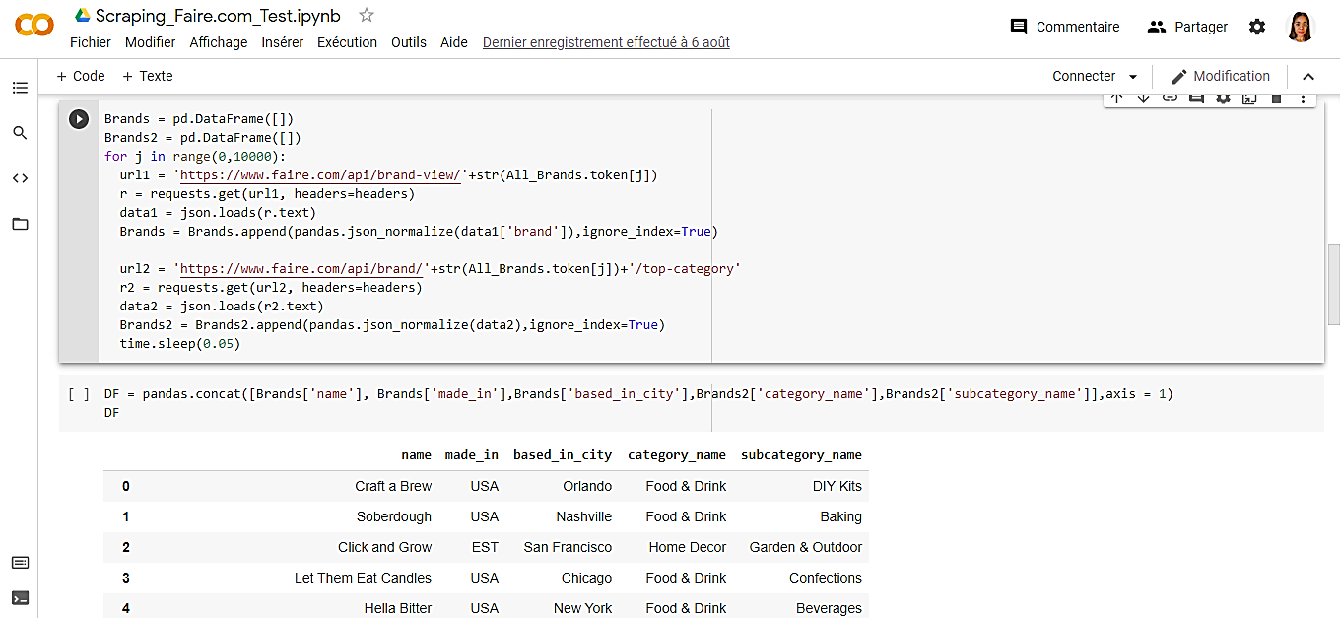
We will recover the link of the token «b_dd0d5049» as we did earlier and we will use it in the code

Slide 10
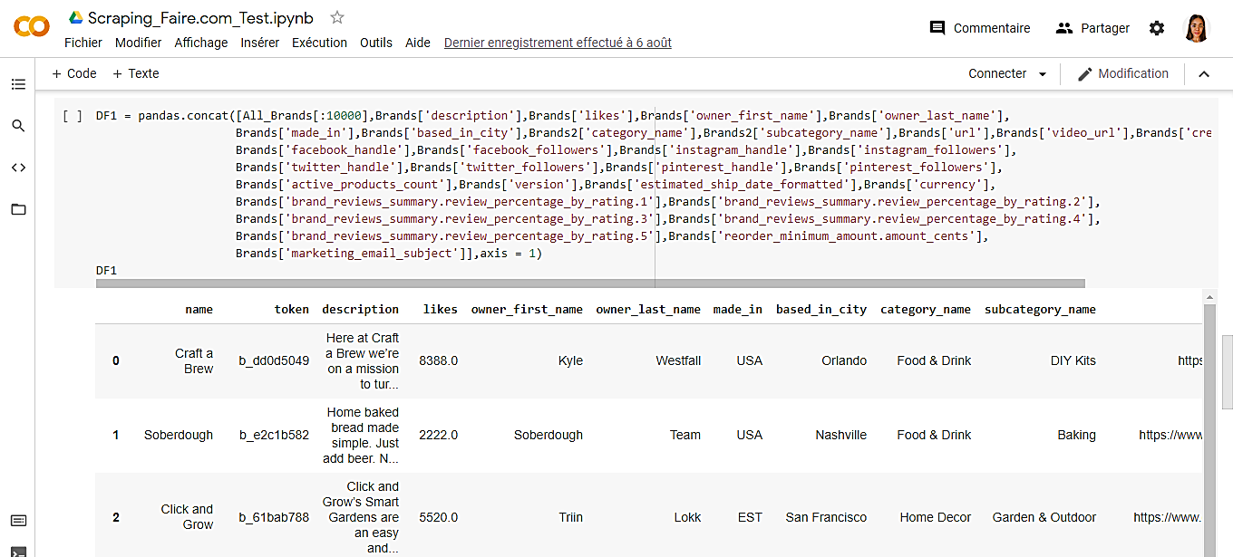
Enrich Faire.com brand with other Informations

Slide 11

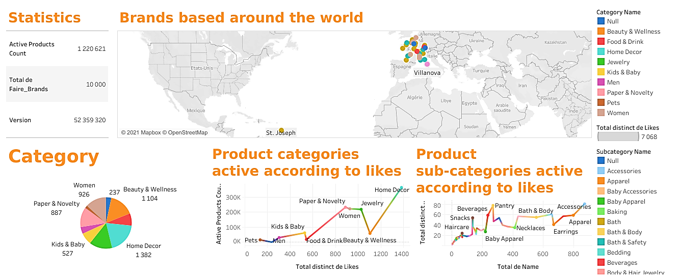
Dashboard
using the final data set and the Tableau visualization tool

Slide 12
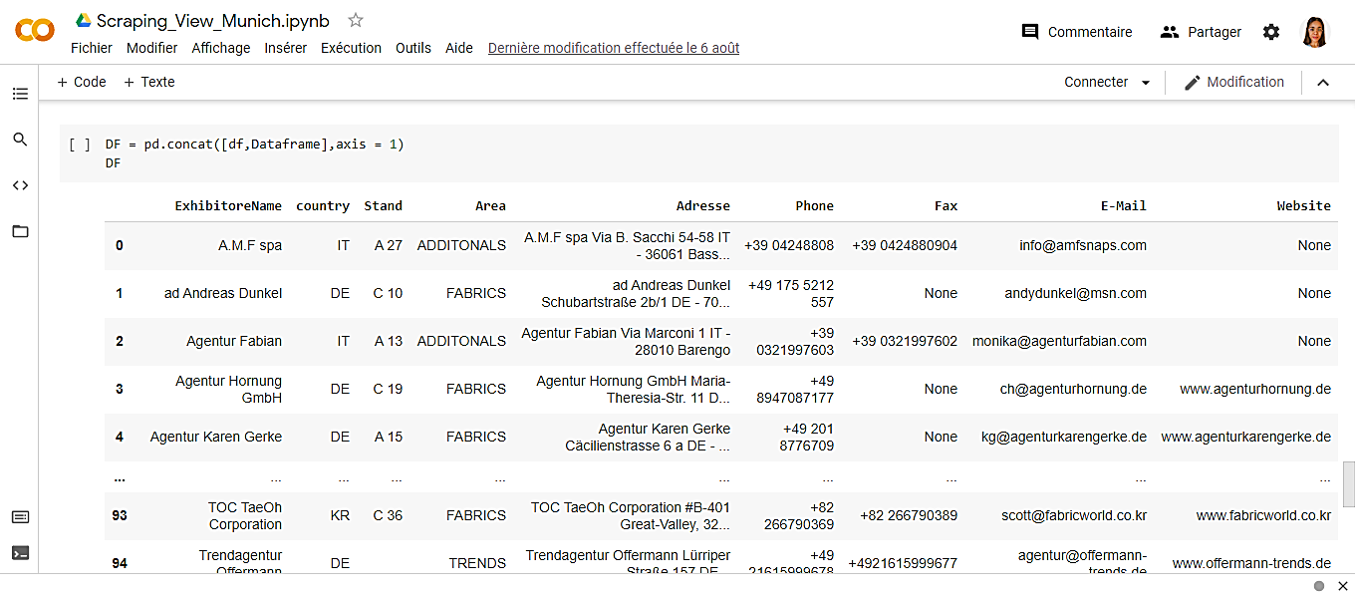
View Munich Scraping by using Html tags

Slide 13
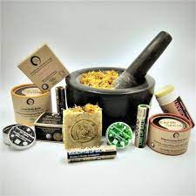
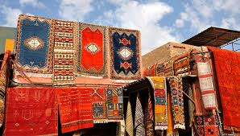
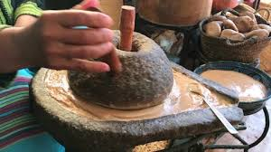
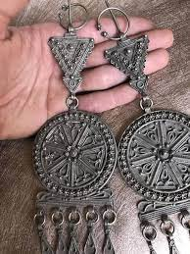
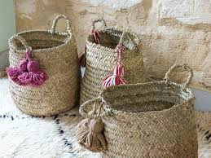
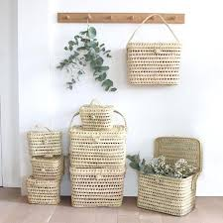
Thank You!
Houda EL BACHRI

